Slide 1
Recipe Review
Amir Ali & Jacek Czupyt & Stanislaw Matuszewski

Slide 2
Outline
Introduction
Data Collection
Exploratory Data Analysis (EDA)
Data Preprocessing
Methodology
Results & Conclusions
Reference

Slide 3
Introduction
Food computing is currently a rapidly growing research field. Natural Language Processing (NLP) is becoming increasingly important, especially in recognizing food entities [1]. We introduced a new dataset – called FoodReview.
The main idea is to analyze the reviews of different foods and extract the ingredients from the comments.
[1] Wróblewska, A., Kaliska, A., Pawłowski, M., Wiśniewski, D., Sosnowski, W., & Ławrynowicz, A. (2022). TASTEset -- Recipe Dataset and Food Entities Recognition Benchmark. arXiv. https://doi.org/10.48550/arXiv.2204.07775

Slide 4
Problem Statement
Food computing field of research
Our project’s goals:
Detection of recipe ingredients inside of collected comments

Slide 5
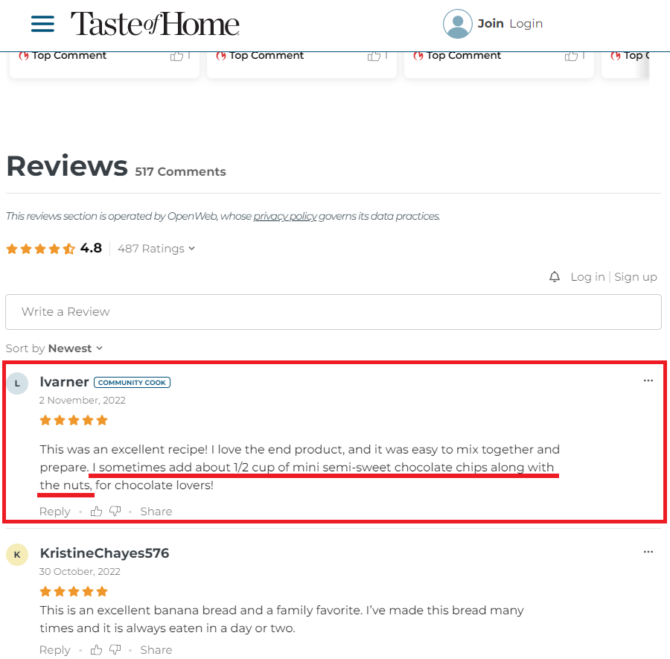
Example

Slide 6
Related works
TASTEset - RECIPE DATASET AND FOOD ENTITIES RECOGNITION BENCHMARK [1]
A Cooking Recipe Multi-Label Classification Approach for Food Restriction Identification [2]
A Named Entity-Based Approach to Model Recipes [3]
Ratatouille: A tool for Novel Recipe Generation [4]

Slide 7
Challenge
Is there any available public dataset related to food recipes with reviews?
Is there any specific model which can extract Ingredients based on reviews?

Slide 8
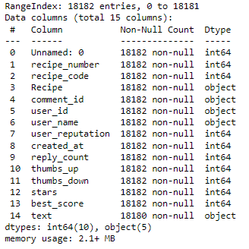
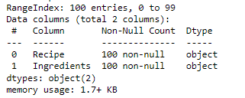
Data Collection
This Dataset is about Recipes Reviews and Ingredients
Recipes Review
Recipes Ingredients

Slide 9
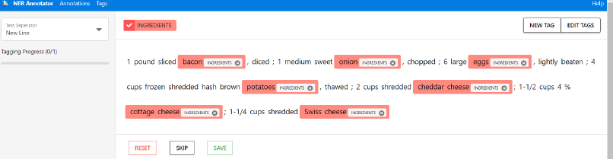
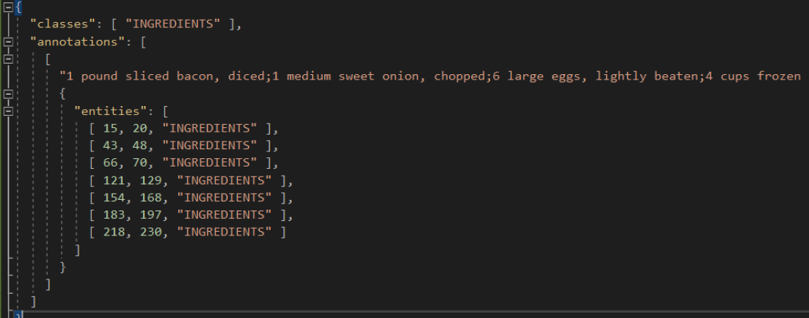
Data Annotations
Adding anotations - NER Anontator interface
Adding annotations - an output JSON file

Slide 10
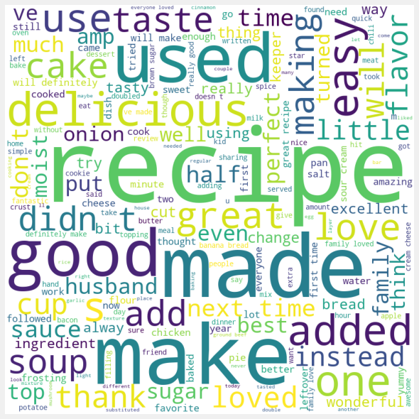
EDA – wordcloud

Slide 11
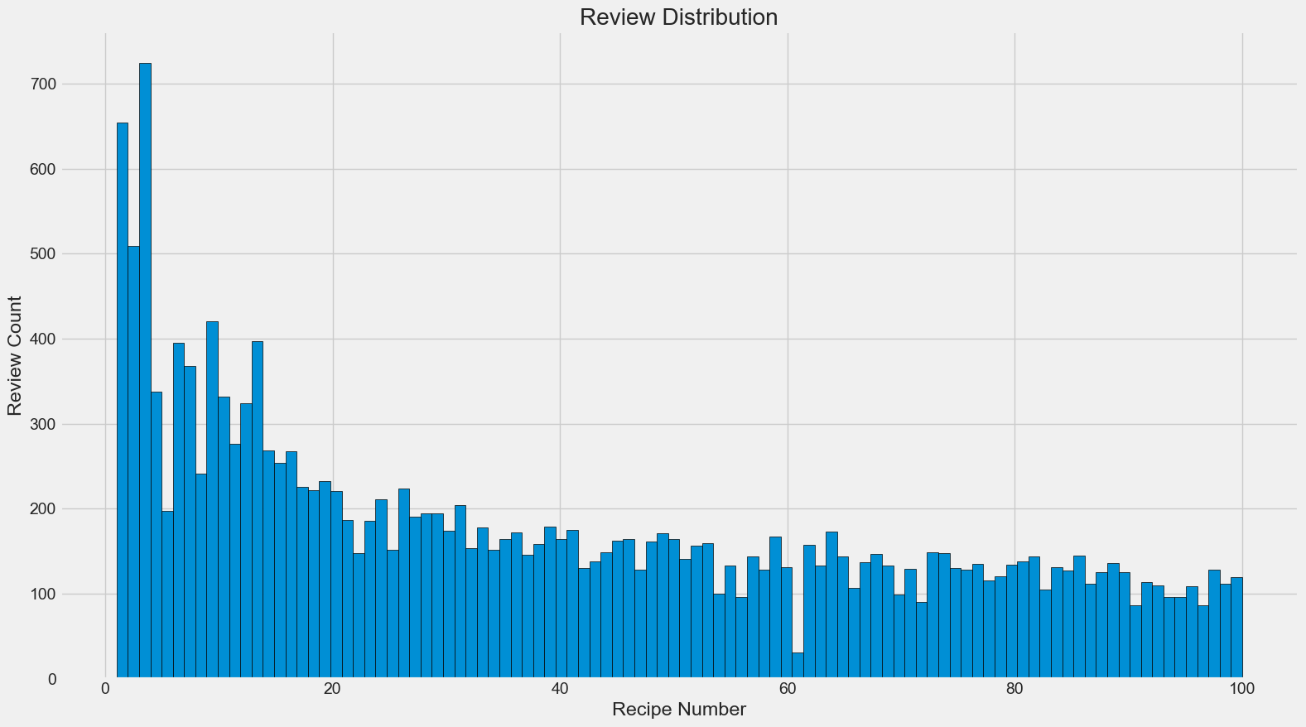
Recipes Review Distribution

Slide 12
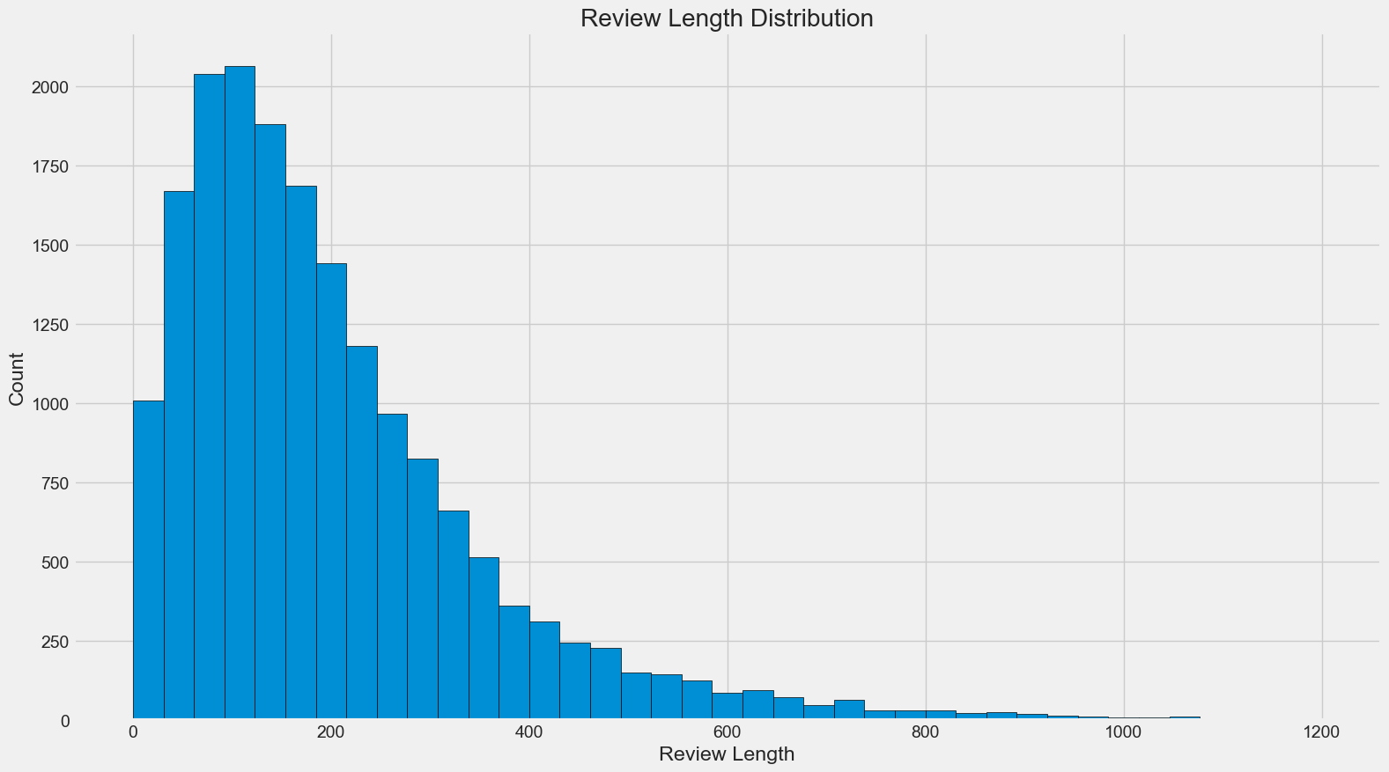
Review Length Distribution

Slide 13
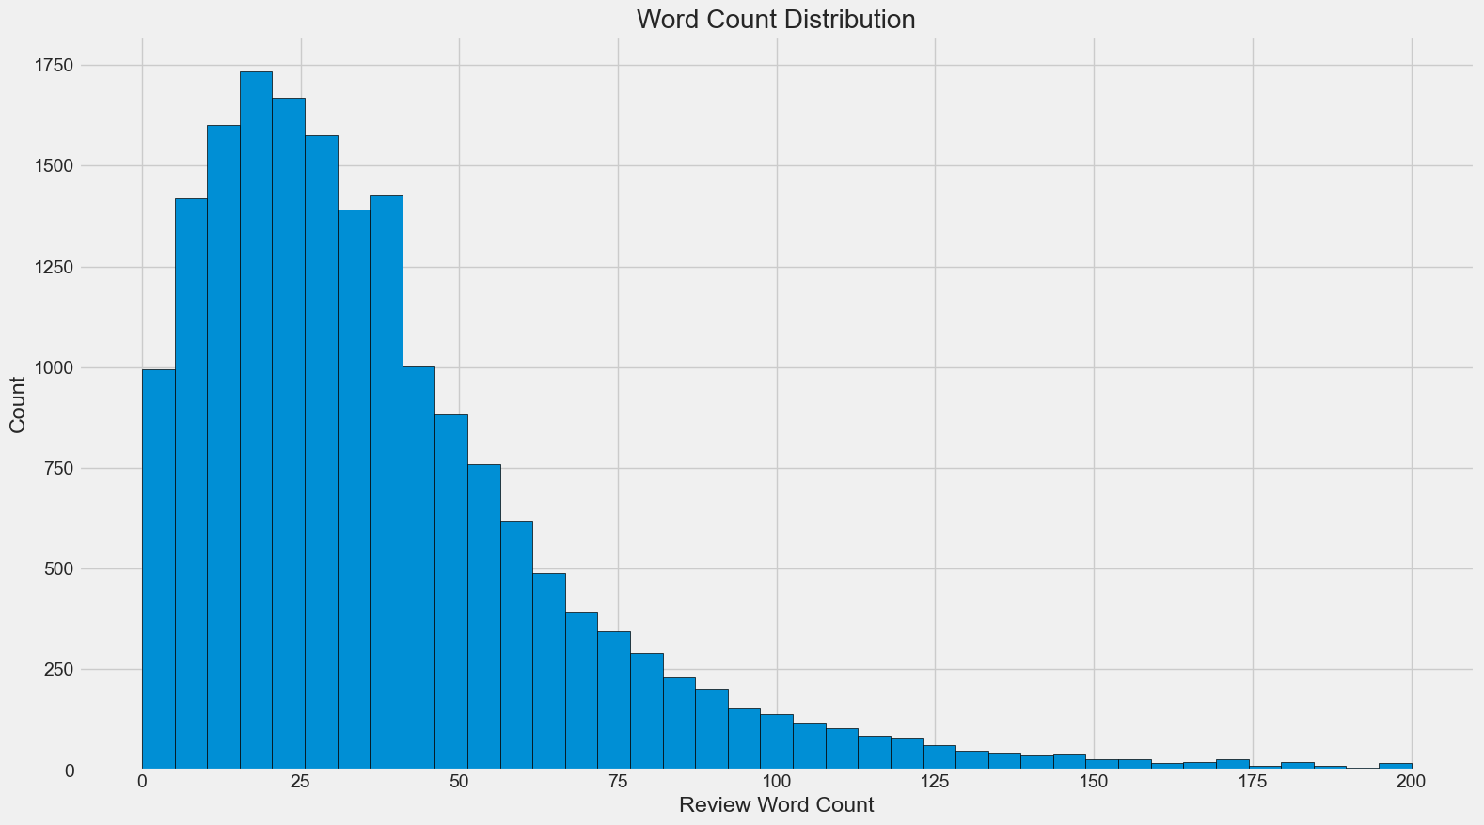
Review Word Count Distribution

Slide 14
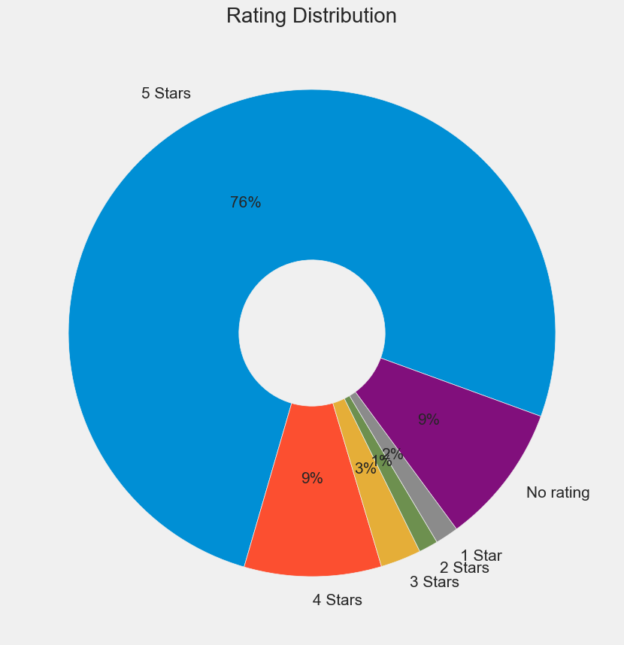
Review Ratings Distribution

Slide 15
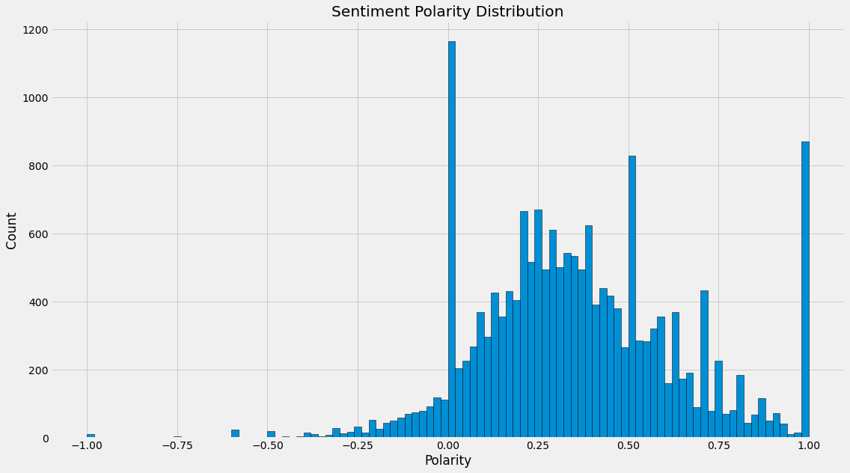
Sentiments Polarity Distribution

Slide 16
Data Preprocessing
Text Cleaning
Lowercase
Remove Punctuation
Remove Special Characters
Preprocessing Operations
Tokenization
Removing Stop Words
Lemmatization

Slide 17
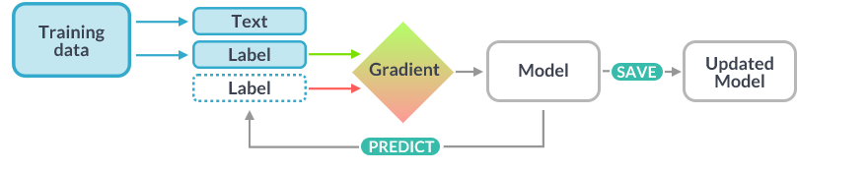
Methodology
Custom Spacy NER 3.0
Figure: Spacy 3.0 Model
1. Experiment with Learning rate
2. Experiment with Hidden layers
3. Experiment with Activation Function

Slide 18
Result
Custom Spacy NER | F-Measure | Precision | Recall
Learning Rate | 0.67 | 0.71 | 0.69
Hidden layer | 0.52 | 0.58 | 0.54
Activation Function | 0.59 | 0.67 | 0.60
Table 1: Final Results

Slide 19
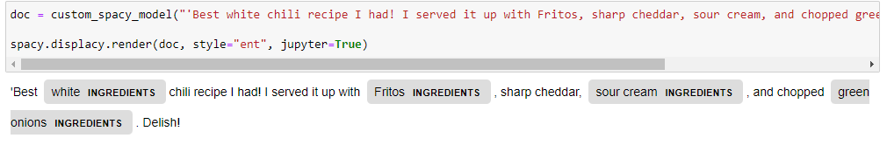
Example Output
Figure: Final Output

Slide 20
Conclusion
We collected very new dataset with crucial information about Recipe Review and Ingredients. We build our own custom model to extract Ingredients from Review.
But this data was not enough to train model perfectly. So, we need more annotated data to improve the model accuracy.

Slide 21
Reference
[1] Wróblewska, A., Kaliska, A., Pawłowski, M., Wiśniewski, D., Sosnowski, W., & Ławrynowicz, A. (2022). TASTEset -- Recipe Dataset and Food Entities Recognition Benchmark. arXiv. https://doi.org/10.48550/arXiv.2204.07775
[2] Gashi, Shkurta & Di Lascio, Elena & Santini, Silvia. (2021). Multi-class Multi-label Classification for Cooking Activity Recognition. 10.1007/978-981-15-8269-1_7.
[3] N. Diwan, D. Batra and G. Bagler, "A Named Entity Based Approach to Model Recipes," 2020 IEEE 36th International Conference on Data Engineering Workshops (ICDEW), 2020, pp. 88-93, doi: 10.1109/ICDEW49219.2020.000-2.
[4] M. Goel et al., "Ratatouille: A tool for Novel Recipe Generation," 2022 IEEE 38th International Conference on Data Engineering Workshops (ICDEW), 2022, pp. 107-110, doi: 10.1109/ICDEW55742.2022.00022.
[5] https://www.tasteofhome.com/collection/our-100-highest-rated-recipes-ever/
[6] MacCartney B (2014) Understanding Natural Language Understanding, ACM SIGAI Bay Area Chapter Inaugural Meeting
[7] Ahmad, Imtiaz. (2022). Parts of Speech in English Grammar.

Slide 22
Thank You for attention!

